Slide 1
British Government System

Slide 2
Chapter goals
To know the system of government in Britain today
  The role of the Queen
  The elements of British Parliament and the role of each element
  The Ministers and the Cabinet and their executive power
  The house of Lords and its special judicial function

Slide 3
Political System of Britain
The British government is a constitutional monarchy.
  a government where the power of the king (or queen) is restrained by the parliament
  King John and the Magna Carta
  1688 the Constitutional Monarchy began
  The Bill of Rights which was passed in 1689

Slide 4
The British political system of government is based on the theory of triumvirate, according to which the state power is divided into three: the legislation, the administration, and the jurisdiction.

Slide 5
The Structure of Central Government
MONARCH
(non-political)
Formal Head of State and Commonwealth
LEGISLATURE
Parliament:-political
House of commons,
chaired by Speaker
(651 MPS)
House of Lords,
hereditary & life peers
EXECUTIVE
Prime Minister and Ministers(25),
(Political Heads of Government Departments), all MPs, form Cabinet
Civil Service(non-political)
Permanent officials employed by government. Advise Ministers and implement policy. Top officials popularly known as ‘mandarins’
JUDICIARY
(Non-political)
Headed by Lord
Chancellor, a leading
Law Lord appointed
by the Prime Minister
House of Lords is the
highest court.

Slide 6
The Constitution
The constitution is simply the set of rules that decree how its government is to be organized. The British Constitution is unwritten. Its components include Acts of Parliament, the Prerogative of the Crown, Conventions of the Constitution, Common Law and Parliamentary Privilege. It is more flexible than the written ones in other countries.

Slide 7
Development of the Constitution
Decline in powers of the Monarch, and establishment of the sovereignty of Parliament
advent of democracy
the decline in the powers of the House of Lords
growth of the party system

Slide 8
Monarch
Clip from “Queen Elizabeth II”

Slide 9
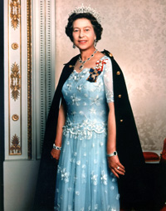
Personifies the state
head of the judiciary
head of the executive
an integral part of the legislature
commander-in-chief of all armed forces of the Crown
the ‘supreme Governor’ of the Church of England

Slide 10
She summons, prorogues (temporarily suspends) and dissolves Parliament; She confirms major public appointments such as government ministers, judges, diplomats, Church of England bishops, and of course, the new Prime Minister after an election.
She has the power to declare war, make peace, recognize foreign states and conclude treaties.
Conferring honors, such as peerages and knighthoods

Slide 11
The king (queen) is also involved in the day-to-day workings of government.
She holds meetings of the Privy Council
She has meetings with ministers and other holders of office at home and overseas
She reads dispatches and signs countless documents and state papers;
In her weekly sessions with the Prime Minister, she receives reports of Cabinet meetings

Slide 12
In practice, the real power of monarchy has gradually been reduced and today the Queen acts solely on the advice of her ministers.
The king (queen) reigns, but she does not rule
His (Her) principal role is symbolic.
Everything has been decided in advance by the parliament or the Prime Minister together, with his Cabinet.
The King (Queen) is informed and consulted on every aspect of national life but at all times she must show complete impartiality.

Slide 13
The Monarch
The monarch is bound by statute to:
not be a Roman Catholic or marry a Roman Catholic
on the death of a monarch, the oldest male heir will succeed to the throne
She must represent the nation’s present-day hopes and ideals as well as its historic past. She is also a symbol of the spirit of the Commonwealth.

Slide 14





Queen Elizabeth II (1926)
The Queen's sons and daughter
Charles Prince of Wales | Anne Princess Royal | Andrew Duke of York | Edward Earl of Wessex

Slide 15


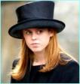




The Queen's Grandchildren
Prince William of Wales (1982) | Peter Phillips (1977) | Princess Beatrice of York (1988) | Lady Louise Windsor (2003)
Prince Harry of Wales (1984) | Zara Phillips (1981) | Princess Eugenie of York (1990) | Viscount Severn

Slide 16
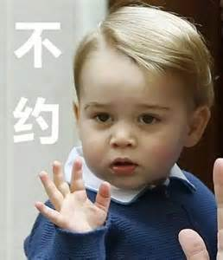
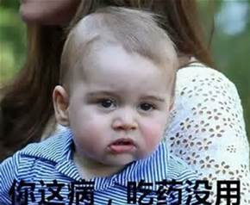
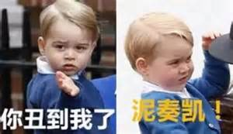
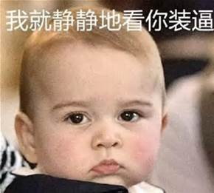
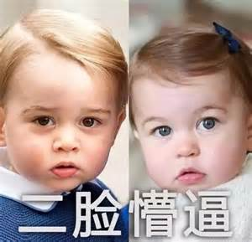

Slide 17
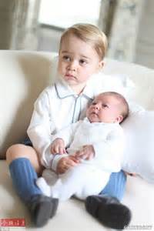
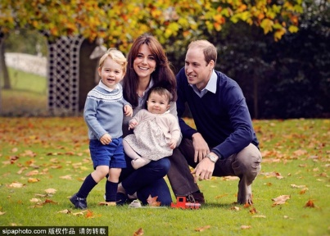

Slide 18
Election Procedure
General Election is held at least every five years. The country is divided into 650 constituencies, each of which returns one Member of Parliament.
Any citizen over the age of 18 can vote in the constituency where he usually resides; only criminals, lunatics, and members of the House of Lords are disqualified from voting.

Slide 19
The one who has the most votes is successful, and will go to Westminster as Member of Parliament for that constituency. And thus the people of the country have chosen the 650 men and women who will make up the House of Commons until the next General Election.

Slide 20
The leader of the party with the largest number of members returned to the House of Commons becomes Prime Minister and is invited by the Queen to form a Government. The party with the next largest number of supporters in the Commons becomes the Official Opposition to the Government.

Slide 21
Government
The Prime Minister
Other ministers
The Cabinet—the most senior ministers (decided by the Prime Minister)
The Privy Council(枢密院)

Slide 22
The executive power is vested in the Ministers, especially in the Cabinet --- the Prime Minister and his most important colleagues.
The Government is accountable or responsible to Parliament.

Slide 23
Parliament
It includes three elements; the Crown, the House of Lords and the House of Commons. It is the supreme law-making authority in Britain. The real centre of parliamentary power is in the House of Commons. Other functions include: to control and criticize the executive government; to control the raising and the spending of money.

Slide 24
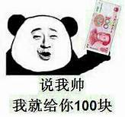
The House of Lords
It is an important part of Parliament. Its members are peers, most of whom are hereditary. Its powers have been severely reduced by the Parliament Acts of 1911 and 1949. It must pass all financial legislation sent to it from the House of Commons, and can delay other Bills for only one year. It has a special judicial function.

Slide 25
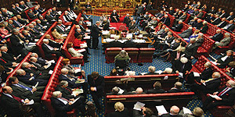
House of Lords ---1175 members
Hereditary and life peers and peeresses
Duke公爵
Marquis侯爵
Earl伯爵
Viscount子爵
Baron男爵
Lords Spiritual神职议员
Lords Temporal世俗议员

Slide 26
The House of Commons
It consists of 650 elected Members of Parliament. MPs have a number of privileges, eg. the freedom of speech in Parliament. It is by far the most powerful and important element in Parliament, therefore plays the key role in the activities of Parliament as a whole.

Slide 27
House of Commons—650 members
Chamber (St. Stephen’s Chapel)
Mr Speaker(议长）
The opposition
(the party that
has won the second
largest number
of seats in
the House of
commons
in the general
Election)
The government

Slide 28
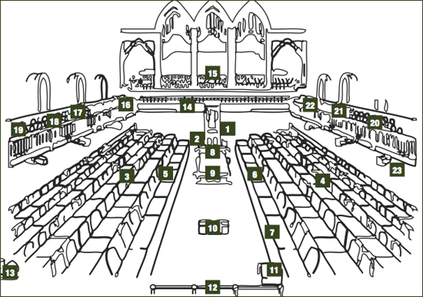
House of Commons
1 Speaker
3 Government Members*
4 Opposition Members*
5 Prime Minister
6 Leader of the Official Opposition
7 Leader of the Second Largest Party in Opposition
8 Clerk and Table Officers
11 Sergeant-at-Arms
14 Press Gallery
15 Public Gallery

Slide 29
The official who presides over the House of Commons is called speaker, who is elected by the House at the beginning of a new parliament. The speaker’s duty is to apply to rules and tradition of the House impartially, considering the rights of all members.

Slide 30
The primary functions of the House of Commons are to make and unmake laws and to supervise the governments and finance.
This function is a traditional power of British Parliament, the process of which undergoes four stages:

Slide 31
(1) Proposing bills .
(2) Holding debates to decide to accept or reject them
(3) The bill is now presented to the House of Lords where it goes through the same stages as in the House of Commons.
(4) Finally the bill is sent to the monarch for approval and is signed and becomes a legal act.

Slide 32
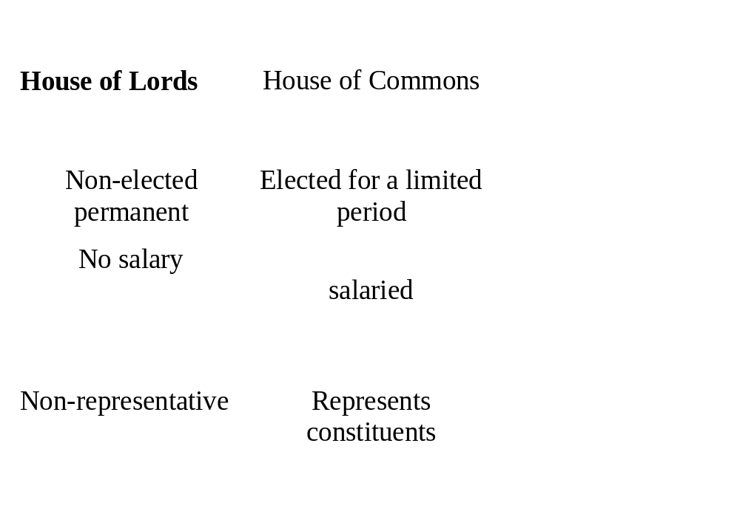
The main differences between the groups within the British state

